Slide 1
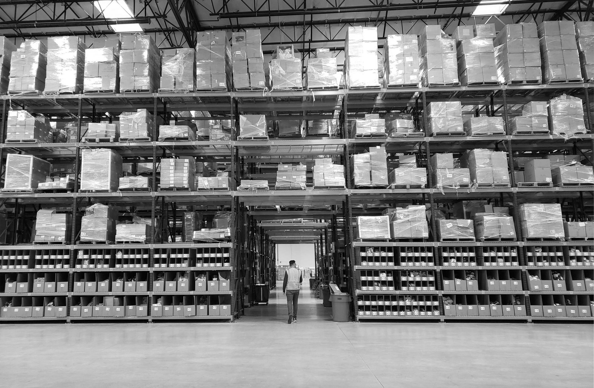



Making e-commerce businesses successful by giving them the power of Amazon logistics
Notes:
Title Slide

Slide 2

Our mission is to be the default logistics and fulfillment solution for the Direct-to-Consumer Ecosystem
Platform
Marketing
Payments
Credit
Logistics & Fulfillment

Slide 3
Our Contribution Margin % has grown from 9% in 2018 to 54% in April 2020.
Actuals YTD 2020

Slide 4
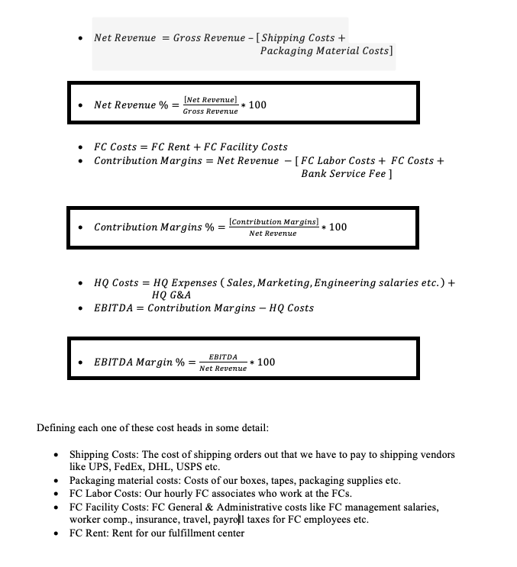
What is Contribution Margin %
Contribution Margin Dollars are the dollars left behind after paying for all the variable and fixed costs of operating our fulfillment network .
A growing Contribution Margin % implies growing leverage in the business .
It is a good proxy of long term EBITDA as HQ costs below CM remain relatively fixed and as net revenue grows quickly, HQ costs become a smaller % of net revenue

Slide 5
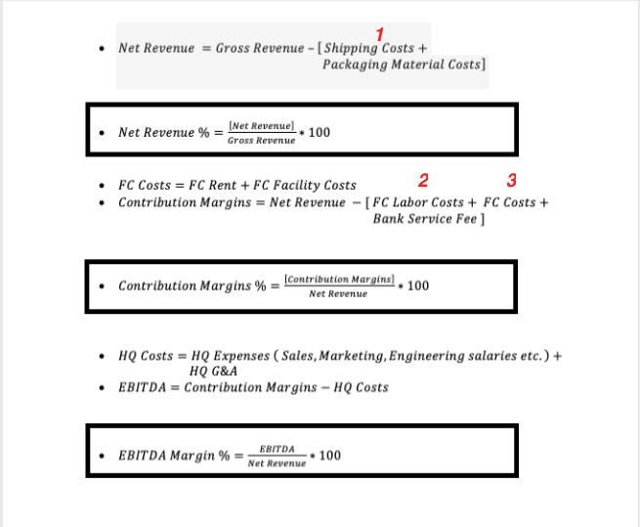
What are the levers for growing Contribution Margin % ?
The 3 big levers for growing Contribution Margin % :
Net Revenue expands as our Shipping Costs go down with scale.
FC Labor Costs as a % of Net Revenue go down
This is measured by VCPO - Variable Costs per Order
3. FC Costs being a fixed cost remain fixed while the net revenue grows.

Slide 6
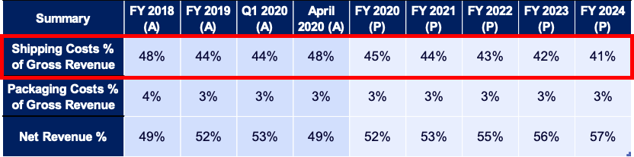
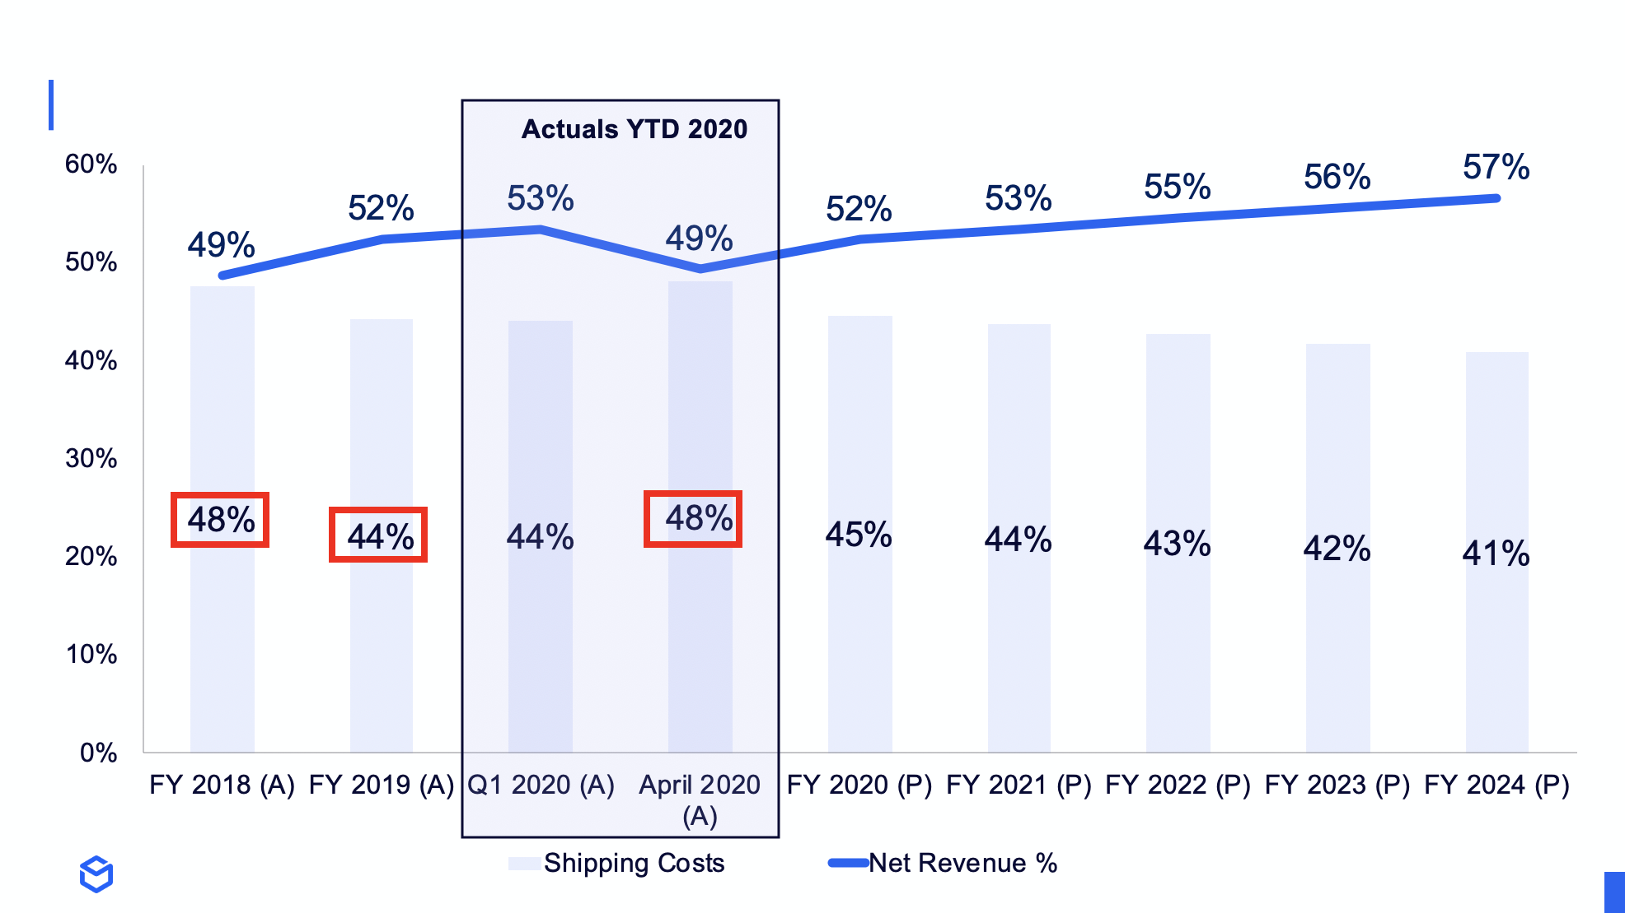
1. Net Revenue Expansion
This is simply a function of scale as we can negotiate volume discounts from shipping carriers with our growing scale.
Our fulfillment prices to our merchants remain fixed but our shipping costs go down. Hence the expansion of the net revenue %.
In 2018 48% of our gross revenue was spent on shipping costs.
In 2019, having doubled in scale, our shipping costs went down 4 points to 44% of revenue in 2019.
In Q1 2020 - our shipping costs were flat to 2019 and 1 point better than what we have projected for 2020.
Going forward while we continue to double our shipping volumes, we anticipate an extremely conservative 1 point of improvement on shipping costs every go forward year.

Slide 7
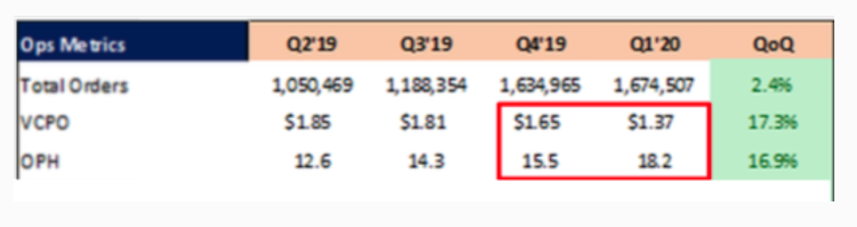
2. FC Labor Costs
We make consistent improvements in the Warehouse Operating Software and the physical processes inside the FC .
This increases the throughput of our FC operations as measured by the OPH metric ( Orders per hour)
This in-turn improves our VCPO metric (Variable Costs per Order ) which is a measure of our labor efficiency
As our FC employees are getting more productive, our labor costs as a % of net revenue goes down. Hence the advantage of owning full stack !
In 2020 Q1 our VCPO was $1.37 - an improvement of 18% over Q4 2019.
This means every order that we have shipped in Q1 2020 cost us 18% less in labor costs compared to 2019!

Slide 8
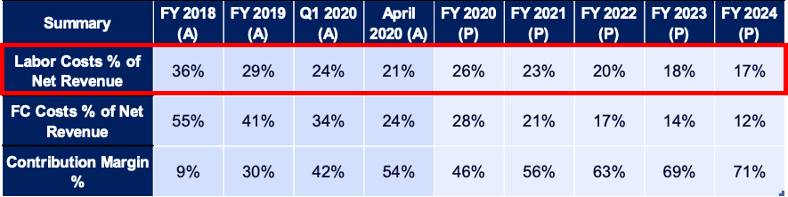
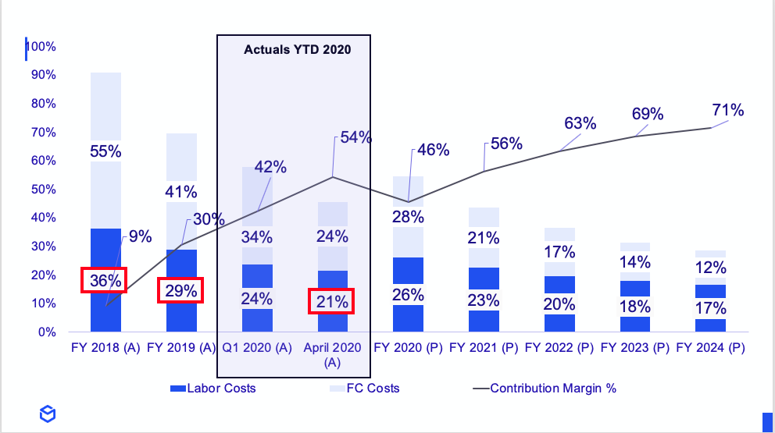
2. FC Labor Costs
By our OPH/ VCPO improvements, our labor costs as a % of net revenue went down 7 points from 36% in 2018 to 29% in 2019.
In April 2020 - our labor spend is at 21 % of net revenue which is close to what we have projected for 2022.
This is because we were able to get more densities in our pick paths and our Warehouse Operating System was able to better allocate processing paths.

Slide 9
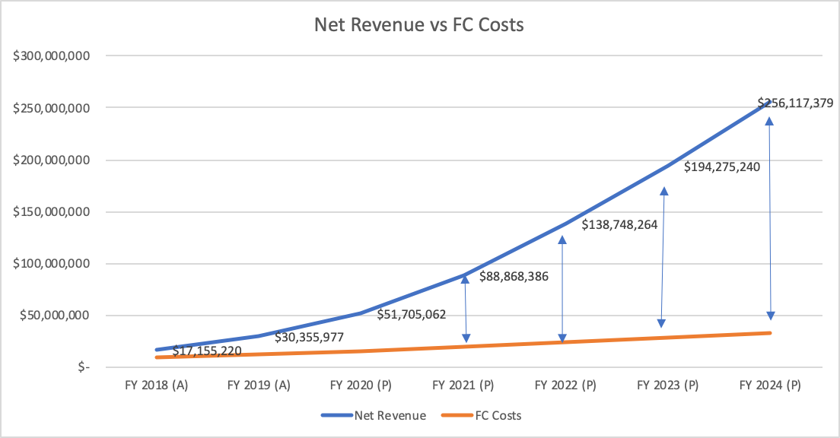
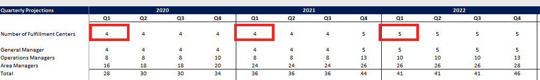
3. FC Rent and FC Costs
This includes our FC rent costs alongside FC management salaries ( General Managers, Operations Managers) , FC utility-bills, FC workers comp. insurance costs etc. - everything needed to keep the FC going.
For every new client that we bring onboard to ShipBob - we don’t open another FC ( no increase in rent) or hire another General Manager / Operations Manager.
So our fixed expenses for renting and managing our fulfillment centers remain flat but we drive more net revenue through the FCs.

Slide 10
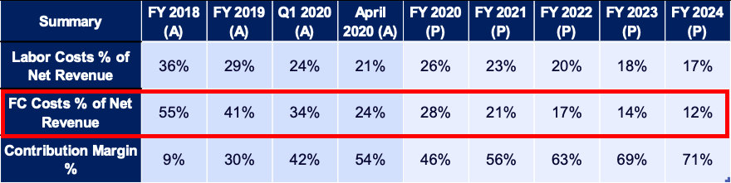
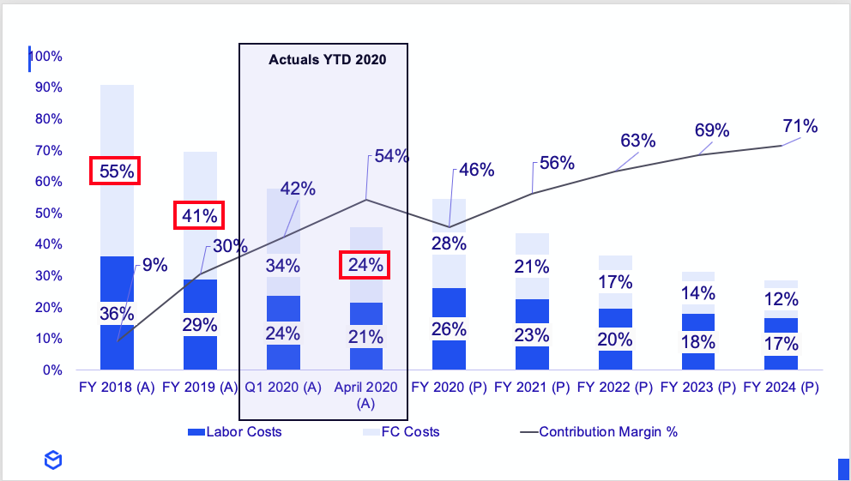
3. FC Rent and FC Costs
Our FC costs as a % of net revenue went down 21 points from 55% in 2018 to 34% in Q1 2020.
In April 2020, our FC costs as a % of net revenue was down another 11 points to 24%.
We will be steady state closer to 12% - which includes the rent and operations expense of adding an additional FC at the end of 2021/early 2022.

Slide 11
Summary
Actuals YTD 2020
The net result of :
1. Shipping Efficiencies
2. Labor Efficiencies
3. FC Fixed Costs remaining fixed
Our Contribution Margins have grown from 9% in 2018 to 30% in 2019 to 54% in April 2020 and steady state to 71%.

Slide 12
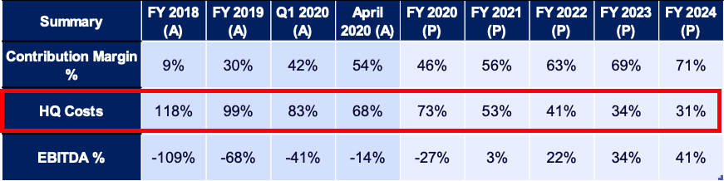
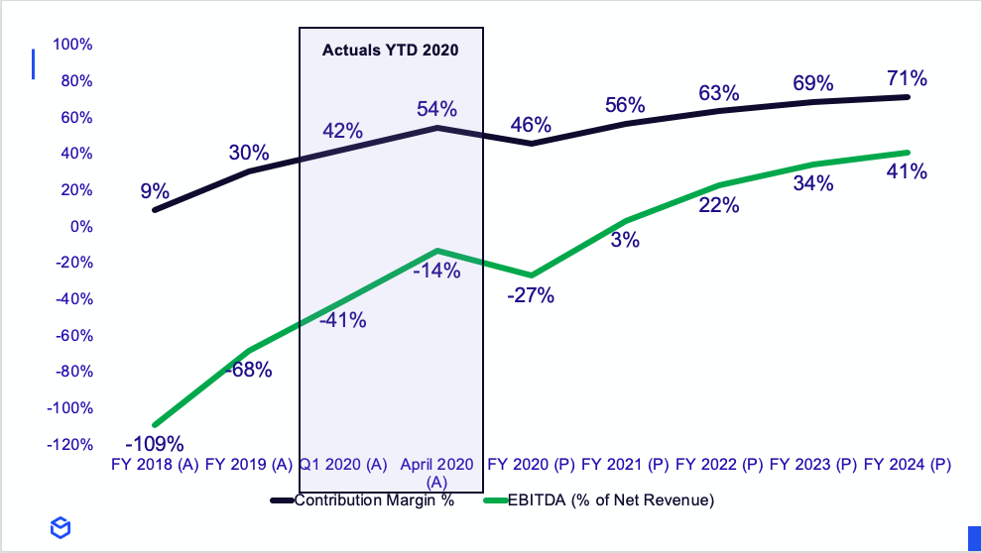
EBITDA Margins
EBITDA $= CM $ - HQ Costs $
EBITDA Margin %= (EBITDA $ / Net Revenue $) %
Long term EBITDA margins are 41% - more than double compared to a typical 3PL while still investing in growth aggressively.

